Slide 1


Affect Detectors Have Scaled in Research but not in Practice
Ryan S. Baker

Slide 2
Ram Kumar Test of Time Award Paper
In 2012, we presented one of the first papers on sensor-free affect detection
Baker, R.S.J.d., Gowda, S.M., Wixon, M., Kalka, J., Wagner, A.Z., Salvi, A., Aleven, V., Kusbit, G., Ocumpaugh, J., Rossi, L. (2012) Towards Sensor-free Affect Detection in Cognitive Tutor Algebra. Proceedings of the 5th International Conference on Educational Data Mining, 126-133.

Slide 3
Not the first such paper
Study | Affective States | Learning Environment
Kapoor et al. (2007) | Frustration | Towers of Hanoi with online learning companion
D'Mello et al. (2008) | Boredom, Confusion, Flow, Frustration | AutoTutor
Conati & Maclaren (2009) | Joy, Distress, Admiration, Reproach | PrimeClimb

Slide 4
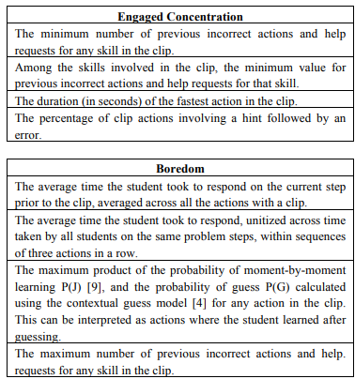
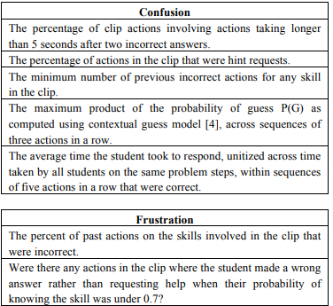
Our paper established that affect detection was possible using just the interaction logs from a digital learning platform, Cognitive Tutor Algebra

Slide 5
Validation
It validated the detectors using unseen data from humans conducting classroom observations

Slide 6
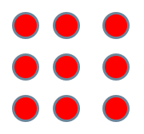

Student-level cross-validation
Split data points into N equal-size groups
Train on all groups but one, test on last group
For each possible combination

Slide 7
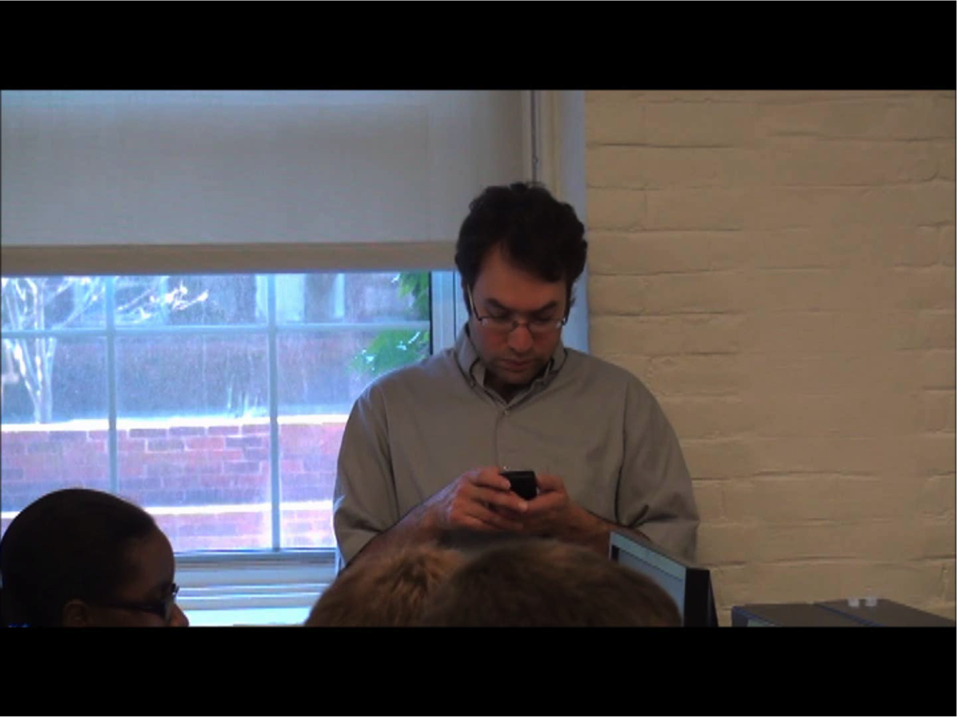
Observations using BROMP protocol (Ocumpaugh et al., 2015; Baker et al., 2020)
Coding based on holistic observations (Planalp et al., 1996).
Context is very important for these constructs, so relying on single cues is unreliable.
BROMP observers are trained to notice posture, facial expressions, verbalizations and environment.
Notes:
Planalp, S., DeFrancisco, V.L., Rutherford, D. (1996) Varieties of Cues to Emotion in Naturally Occurring Settings. Cognition and Emotion, 10 (2), 137-153.

Slide 8
The contribution
This established a paradigm for the development and validation of these types of EDM models
Since then, other types of validation also used (algorithmic bias, leave-out-one-population)
But it became difficult to get papers published if they – for example – only used flat cross-validation
In other work, self-report, expert video labeling, sensors also used to label

Slide 9
Since then
Dozens of affect detectors developed by scholars around the world
Providing increasingly high-quality measurements of students’ boredom, frustration, confusion, and engaged concentration/flow, and occasionally other affective states such as anxiety and delight.
Botelho et al., 2017 ASSISTments
Jiang et al., 2018 Betty’s Brain
Hutt et al., 2019 Algebra Nation
De Morais & Jaques, 2023 PAT2Math
Zambrano et al., 2024 Crystal Island
Rahman et al., 2024 ASSISTments
Notes:
Botelho, A.F., Baker, R., Heffernan, N. (2017) Improving Sensor-Free Affect Detection Using Deep Learning. Proceedings of the 18th International Conference on Artificial Intelligence in Education, 40-51.
Jiang, Y., Bosch, N., Baker, R. S., Paquette, L., Ocumpaugh, J., Andres, J. M. A. L., ... & Biswas, G. (2018). Expert feature-engineering vs. deep neural networks: which is better for sensor-free affect detection?. In Artificial Intelligence in Education: 19th International Conference, AIED 2018, London, UK, June 27–30, 2018, Proceedings, Part I 19 (pp. 198-211). Springer International Publishing.
Hutt, S., Grafsgaard, J. F., & D'Mello, S. K. (2019, May). Time to scale: Generalizable affect detection for tens of thousands of students across an entire school year. In Proceedings of the 2019 CHI conference on human factors in computing systems (pp. 1-14).
de Morais, F., & Jaques, P. A. (2023). Improving sensor-free affect detection by considering students' personality traits. IEEE Transactions on Learning Technologies, 17, 542-554.
Zambrano, A. F., Nasiar, N., Ocumpaugh, J., Goslen, A., Zhang, J., Rowe, J., ... & Hutt, S. (2024). Says Who? How different ground truth measures of emotion impact student affective modeling. In Proceedings of the 17th International Conference on Educational Data Mining (pp. 211-223).
Rahman, M. M., Ollington, R., Yeom, S., & colleagues (2024). “Generalisable sensor-free frustration detection in online learning environments using machine learning.” User Modeling and User-Adapted Interaction, 34, 1493-1527.

Slide 10
The resultant detectors
Used in a large range of studies investigating affect
Fine-grained studies on affect dynamics
Botelho et al., 2018
Research on the interaction between affect and behavior or other processes such as self-regulated learning
Baker et al., 2021
Andres et al., 2021
Ocumpaugh et al., 2025
Research on the longitudinal implications of negative affect.
San Pedro et al., 2013
Pardos et al., 2014
Notes:
San Pedro, M.O.Z., Baker, R.S.J.d., Bowers, A.J., Heffernan, N.T. (2013) Predicting College Enrollment from Student Interaction with an Intelligent Tutoring System in Middle School. Proceedings of the 6th International Conference on Educational Data Mining, 177-184.
Pardos, Z.A., Baker, R.S., San Pedro, M.O.C.Z., Gowda, S.M., Gowda, S.M. (2014) Affective states and state tests: Investigating how affect and engagement during the school year predict end of year learning outcomes. Journal of Learning Analytics, 1 (1), 107-128
Botelho, A.F., Baker, R., Ocumpaugh, J., Heffernan, N. (2018) Studying Affect Dynamics and Chronometry Using Sensor-Free Detectors. Proceedings of the 11th International Conference on Educational Data Mining, 157-166. [note EDM best paper nomination]
Baker, R.S., Nasiar, N., Ocumpaugh, J.L., Hutt, S., Andres, J.M.A.L., Slater, S., Schofield, M., Moore, A., Paquette, L., Munshi, A., Biswas, G. (2021) Affect-Targeted Interviews for Understanding Student Frustration. Proceedings of the International Conference on Artificial Intelligence and Education.
Andres, J.M.A.L., Hutt, S., Ocumpaugh, J., Baker, R.S., Nasiar, N., Porter, C. (2021) How Anxiety Affects Affect: A Quantitative Ethnographic Investigation using Affect Detectors and Data-Targeted Interviews. Proceedings of the International Conference on Quantitative Ethnography.
Ocumpaugh, J., Nasiar, N., Zambrano, A. F., Goslen, A., Vandenberg, J., Esiason, J., ... & Hutt, S. (2025, March). Refocusing the lens through which we view affect dynamics: The Skills, Difficulty, Value, Efficacy and Time Model. In Proceedings of the 15th International Learning Analytics and Knowledge Conference (pp. 192-203).

Slide 11
And yet
Unlike other EDM algorithms and models

Slide 12
And yet
Unlike other EDM algorithms and models
Unlike, say, knowledge tracing or dropout prediction
Affect detectors are generally not in scaled deployment in real-life learning technologies.
Knowedge Tracing used at scale to drive mastery learning and reports to teachers in dozens of platforms -- MATHia, MHE Reveal, Inq-ITS, Duolingo, Squirrel AI
Dropout Prediction serving millions of students -- Civitas, BrightBytes (RIP), Infinite Campus, D2L, Course Signals (RIP), Intellischool, Jisc

Slide 13
That said
Individual papers have demonstrated the potential of individualized affect responses for benefiting learners
Robison et al., 2009
D’Mello et al., 2010
Arroyo et al., 2011
DeFalco et al., 2018
Rajendran et al., 2018
Notes:
DeFalco, J.A., Rowe, J.P., Paquette, L., Georgoulas-Sherry, V., Brawner, K., Mott, B.W., Baker, R.S., Lester, J.C. (2018) Detecting and Addressing Frustration in a Serious Game for Military Training. International Journal of Artificial Intelligence and Education, 28 (2), 152-193
Arroyo, I., Woolf, B. P., Cooper, D. G., Burleson, W., & Muldner, K. (2011, July). The impact of animated pedagogical agents on girls' and boys' emotions, attitudes, behaviors and learning. In 2011 IEEE 11th international conference on Advanced learning technologies (pp. 506-510). IEEE.
Rajendran, R., Iyer, S., & Murthy, S. (2018). Personalized affective feedback to address students’ frustration in ITS. IEEE Transactions on Learning Technologies, 12(1), 87-97. https://www.cse.iitb.ac.in/~sri/papers/affectiveFeedback-TLT2019.pdf
D’Mello, S., Lehman, B., Sullins, J., Daigle, R., Combs, R., Vogt, K., ... & Graesser, A. (2010). A time for emoting: When affect-sensitivity is and isn’t effective at promoting deep learning. In Intelligent Tutoring Systems: 10th International Conference, ITS 2010, Pittsburgh, PA, USA, June 14-18, 2010, Proceedings, Part I 10 (pp. 245-254). Springer Berlin Heidelberg.
Robison, J., McQuiggan, S., & Lester, J. (2009, September). Evaluating the consequences of affective feedback in intelligent tutoring systems. In 2009 3rd international conference on affective computing and intelligent interaction and workshops (pp. 1-6). IEEE.

Slide 14
But…
The adaptivity or reporting demonstrated in these papers has not made it into the ongoing functionality of learning systems used at scale.

Slide 15
Why has this been the case?
I have some hypotheses
I'd like to hear your thoughts on them.

Slide 16

Raise your hand
Everyone here who works at a vendor -- industry or academia -- that delivers learning content to at least 500 students a year
Raise your hand

Slide 17
Thank you
Only you folks get to answer the next set of questions

Slide 18
Which
Which of these hypotheses seem plausible to you, as a major cause for why detectors haven't scaled?
Raise your hand, I'll count hands.

Slide 19
Hypothesis A
Detector performance, while good enough for aggregate research, isn't good enough to drive actual decision making

Slide 20
Hypothesis B
Detectors are too reliant on very contingent features and when something changes in a small way in the interface, the detectors might stop working (aka detector rot; Levin et al., EDM2022), making interventions not be long-term sustainable
Notes:
Levin, N., Baker, R.S., Nasiar, N., Fancsali, S., Hutt, S. (2022) Evaluating Gaming Detector Model Robustness Over Time. Proceedings of the 15th International Conference on Educational Data Mining

Slide 21
Hypothesis C
Cross-domain, cross-population & cross-interface transfer still degrades model performance
Users and teachers will tolerate an inaccurate skill estimate, but a system that misreads a learner’s emotions feels creepy or untrustworthy
So, vendors avoid the risk

Slide 22
Hypothesis D
Building (and periodically re-calibrating) interaction-log affect detectors still requires human observation, self-report, or sensor-based labels—far costlier than logs used for other kinds of detectors

Slide 23
Hypothesis E
People don't really believe that affect matters, because we don't have enough good examples of it really making a big difference to students’ lives
Unlike – for example -- grit or knowledge

Slide 24
Hypothesis F
It's hard to think of interventions that would really make a difference in either changing affect in a sustainable way, or producing better life results.
There’s no must-have feature that drives adoption the way that mastery forecasts or dropout-risk flags do

Slide 25
Hypothesis G
Compared with knowledge tracing—which links directly to content sequencing—affect interventions are:
Harder to act on
Require bigger interventions
Might be thought to deliver smaller, less predictable benefits when weighed against the engineering, compute, and UX complexity

Slide 26
Hypothesis H
Interventions that will be beneficial to a student who is bored or frustrated will be beneficial to just about everybody in a whole lot of cases
So why do we need the detection?
Example: games, personalization, self-explanations after errors, worked examples

Slide 27
Hypothesis I
Schools, parents, children, or community members find affect detection more concerning than figuring out what a kid knows

Slide 28
OK, so it looks like our winners are:

Slide 29
So how do we address these problems?
I'll focus on the ones our scaled-platform contributors picked.

Slide 30
Your ideas
You might have other ideas
Email them to me after, if you want
Or post them to Bluesky or LinkedIn or other platforms
Or just write a great paper using them and win the EDM2026 best paper award

Slide 31
Hypothesis A: Performance not good enough to drive decision making
Address performance issues with self-report double-checks
Focus on fail-soft interventions such as after-action reviews or real-time teacher notifications (e.g. Holstein et al., 2018)
Kaggle-style challenges with affect data sets, to push field towards better detection

Slide 32
Hypothesis B: Too reliant on very contingent features and not long-term sustainable
Use schemas to represent interfaces and interface changes, and include them in the detector-building processes
Use LLMs/emerging Operator models to try to create affective profiles that interact with interfaces; fine-tune them with real data from multiple learning environments
Periodic re-collection of self-report data followed by automated retraining and flags to developers if performance significantly worsens

Slide 33
Hypothesis C: Transfer degrades performance, and a system misreading emotion seems creepy
Train models on several different learning environments
Use schemas to represent interfaces and interface changes, and include them in the detector-building processes
Use LLMs/emerging Operator models to try to create affective profiles that interact with interfaces; fine-tune them with real data from multiple learning environments
Calibrate models with a period of self-report for new populations/learning systems
Perhaps active learning (as in Zambrano et al., 2023) can eventually be part of this solution

Slide 34
Hypothesis D: Far costlier than logs because of human observation, self-report, or multi-modal labels
Maybe pre-training across multiple learning environments can eventually help
Use schemas to represent interfaces and interface changes, and include them in the detector-building processes
Use LLMs/emerging Operator models to try to create affective profiles that interact with interfaces; fine-tune them with real data from multiple learning environments
Calibrate models with a period of self-report for new populations/learning systems
Perhaps active learning (as in Zambrano et al., 2023) can eventually be part of this solution
Self-report is probably just inherently cheaper than BROMP or video coding, long term, even though it has limitations

Slide 35
Hypothesis E: People don’t think affect matters in learning because the evidence isn’t strong enough
Maybe we need studies from more research groups showing learning outcome and other outcome impacts of negative affect
There have been some studies, but only a limited number of research groups
Fair's fair, the longitudinal impact of negative affect appears to be weaker than for gaming the system or knowledge

Slide 36
Hypothesis F: Lack of must-have interventions
Try using generative AI and vibe coding to generate a lot of solutions that could be quickly deployed
Like the investigation of teacher-designed hints in ASSISTments (Prihar et al., 2021; for affect specifically, Le Tallec et al., 2025)
Let teachers vibe code their ideas
Create a library of those solutions
Try to embed affect detection into existing SEL interventions and management programs
EDM has became a core part of student dropout prediction, but not SEL management
Maybe we just need to make that connection between fields!

Slide 37
Hypothesis G: Affect interventions seem harder and less useful than knowledge tracing
Creating domain-general micro-solutions that are plug-and-play could help but will be challenging to engineer
Maybe vibe coding and LLM-supported coding can reduce development cost
Maybe this is just a matter of time; as KT becomes more standard and cheap to implement, there will be more time available to pay attention to this

Slide 38
Hypothesis H: Why bother detecting if the intervention would benefit everyone?
Conduct studies to investigate whether affective solutions are genuinely beneficial to everyone
Conduct studies to investigate the benefits of adaptive dosage
Universal solutions (like games) are a lot more development work than brief interventions, and have side effects
In general, our field has not paid enough attention to the drawbacks of mis-applied interventions
Including the drawbacks of deploying universal interventions where not needed

Slide 39
Hypothesis I: Affect detection more concerning than knowledge assessment
This one is hard.
There are a lot of techniques for protecting privacy, and for integrating stakeholders into the design processes
But will parents, teachers, and "community members" even care?
If this is a core issue, it may ultimately lead to affective-sensitive learning environments being available in some countries but not others

Slide 40
The bottom line
Our field has put a lot of effort into affect detection.

Slide 41
I believe
It has been worth the effort!

Slide 42
I believe
It has been worth the effort!
In a sense.

Slide 43
I believe
It has been worth the effort!
In a sense.
Lots of published detectors for lots of learning environments.
Lots of published scientific findings, both in our community and in the broader learning sciences.
A few papers showing benefits to learners.

Slide 44
But at the same time
Affect detection hasn’t yet changed the world as much as KT or disengagement detection or dropout prediction.

Slide 45
There’s still potential to do so
We can still turn this technology from an exciting potential for the future to a reality benefitting millions of students' lives

Slide 46
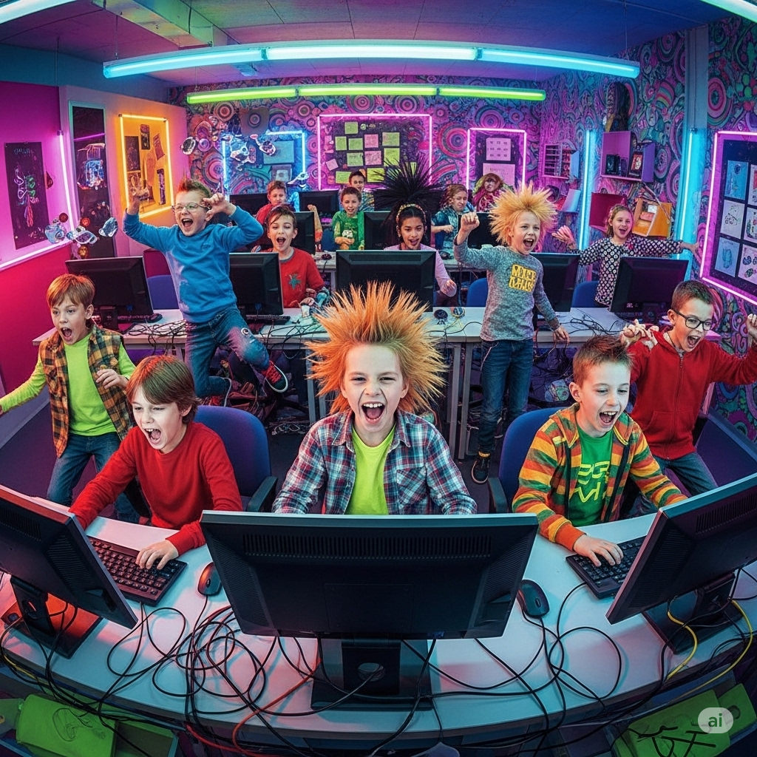
There’s still potential to do so
We can still turn this technology from an exciting potential for the future to a reality benefitting millions of students' lives
The future of affect-sensitive education, according to Gemini

Slide 47
There’s still potential to do so.
We can still turn this technology from an exciting potential for the future to a reality benefitting millions of students' lives.
The future of affect-sensitive education, according to Gemini (alarming on so many levels)

Slide 48
Popping up a level to a bigger landscape

Slide 49
Popping up a level to a bigger landscape
This challenge is part of a class of challenges that I think we should be solving as a field, to achieve our maximum impact

Slide 50
Popping up a level to a bigger landscape
This challenge is part of a class of challenges that I think we should be solving as a field, to achieve our maximum impact
I’ve spoken about this before

Slide 51
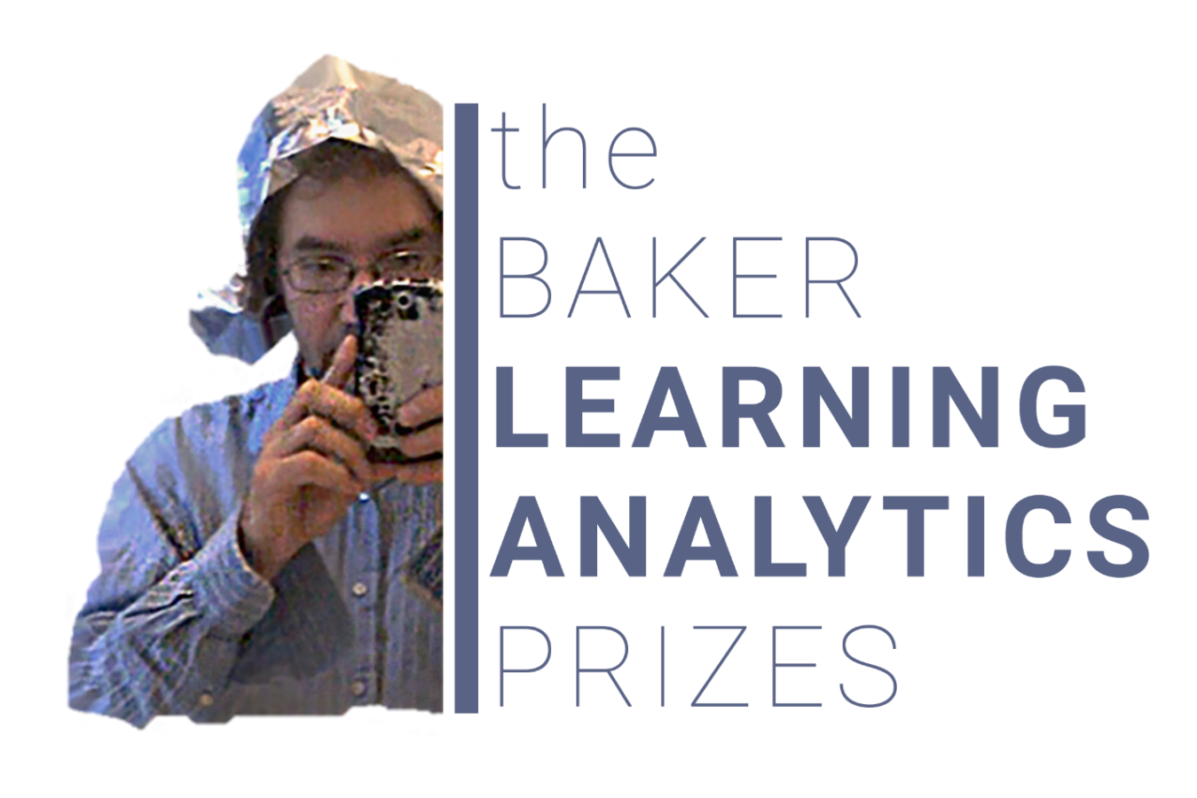
Baker Learning Analytics Prizes
At LAK 2019, I gave a keynote (published in JEDM) on challenges for the future of our field
I proposed six Baker Learning Analytics Prizes, challenges which anyone who could solve would receive $1.

Slide 52
The six challenges
Transferability: The (learning system) Wall
Effectiveness: Differentiating Interventions and Changing Lives
Interpretability: Instructors speak Spanish, Algorithms speak Swahili
Applicability: Knowledge Tracing Beyond the Screen
Generalizability: The General-Purpose Boredom Detector
Generalizability: The NYC and Marfa problem
Notes:
slide 92 from AAAI talk

Slide 53
Affect Intervention Based on Detection: A Special Case of
Transferability: The (learning system) Wall
Effectiveness: Differentiating Interventions and Changing Lives
Interpretability: Instructors speak Spanish, Algorithms speak Swahili
Applicability: Knowledge Tracing Beyond the Screen
Generalizability: The General-Purpose Boredom Detector
Generalizability: The NYC and Marfa problem
Notes:
slide 92 from AAAI talk

Slide 54
The six challenges
BLAP 1 has been solved!
Transferability: The (learning system) Wall
Effectiveness: Differentiating Interventions and Changing Lives
Interpretability: Instructors speak Spanish, Algorithms speak Swahili
Applicability: Knowledge Tracing Beyond the Screen
Generalizability: The General-Purpose Boredom Detector
Generalizability: The NYC and Marfa problem
Notes:
slide 92 from AAAI talk

Slide 55
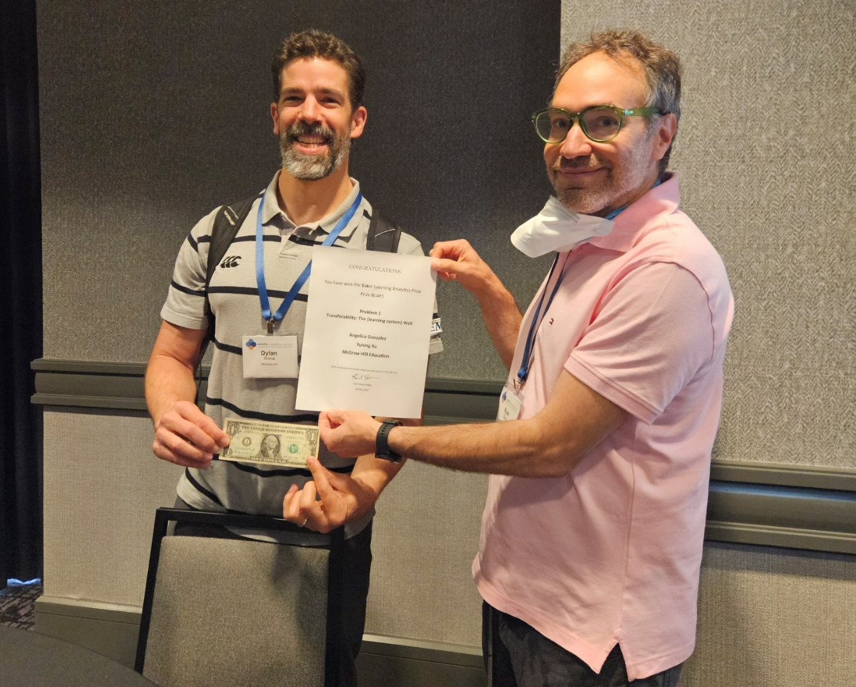
BLAP1 Award-Winner
Angelica Gonzalez & Yuning Xu (2025). Breaking the Learning System Wall with McGraw Hill Plus.
Available at: https://medium.com/inspired-ideas-prek-12/breaking-the-learning-system-wall-with-mcgraw-hill-plus-c3b55ddeb6bd

Slide 56
BLAP On: More $1 awards
BLAP-1-Alpha
BLAP-1, but using models of something other than knowledge/correctness
BLAP-1-Beta
Taking an integrated BLAP-1 model and demonstrating better outcomes for learners in a quasi-experimental or randomized study
BLAP-1-Gamma
BLAP-1, but connecting learning systems not owned by the same parent company or organization

Slide 57
So…
I encourage you all to do more to build EDM-based interventions that make a difference in learners’ lives

Slide 58
So…
I encourage you all to do more to build EDM-based interventions that make a difference in learners’ lives
I encourage you all to take on these challenges (BLAP)

Slide 59
Affect Detection
Make affect detection matter more –
Affect detectors connected to interventions that make a difference in learners’ lives

Slide 60
And
Collect that dollar

Slide 61
And
Collect that dollar
Even though I’m moving across the world, it will be still be a US dollar

Slide 62
And
If you don’t take on one of these challenges

Slide 63
And
If you don’t take on one of these challenges
Take on your own grand challenge

Slide 64
And
If you don’t take on one of these challenges
Take on your own grand challenge
EDM has the potential to change the world for the better, in so many ways

Slide 65
And
If you don’t take on one of these challenges
Take on your own grand challenge
EDM has the potential to change the world for the better, in so many ways
It’s an honor to be part of this community

Slide 66


Thank you!
Ryan Baker
“Big Data and Education”, a free and totally open MOOC
Online Masters and Certificate in Learning Analytics and AI (Penn) All publications available online – Google “Ryan Baker”

